Slide 1
Computer Vision for Data Scientists
Antonio Rueda-Toicen
Data Science Retreat
August 2023

Slide 2
About me
Machine Learning Engineer at Vinted
Background in academia (computer science and bioengineering)
Organizer of the Berlin Computer Vision Group

Slide 3

https://www.meetup.com/Berlin-Computer-Vision-Group/

Slide 4
Agenda
Training image classifiers using FastAI and the one-cycle policy
Semantic segmentation with U-net
Transfer learning for image similarity
Image clustering
Object detection
Bounding box regression
Single shot detectors and YOLO
RCNN family of object detection methods
Image segmentation
Instance vs semantic segmentation
Panoptic segmentation
Fully convolutional networks
Detectron2 framework
Case study: amenity detection in AirBnB

Slide 5
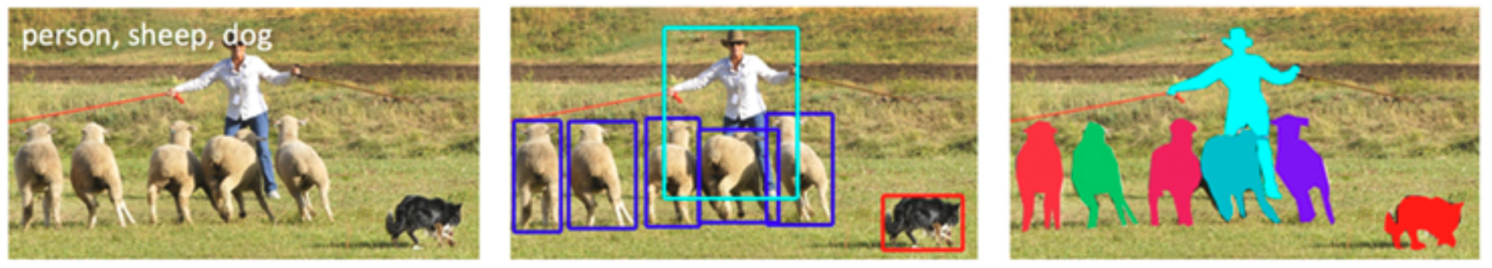
Classification, detection, and segmentation
Classification refers to image-wide labels
Detection refers to localization of bounding boxes with labels
Segmentation refers to pixel-wise localization of the labels

Slide 6
Fastai 2
PyTorch library from Jeremy Howard (former Kaggle president and #1 competitor)
Very active community effort (use its forums!)
It’s the ‘Keras for PyTorch’
Close to PyTorch lightning (but non-scammy)
Originally written in Tensorflow, rewritten in PyTorch in 2017
Completely open license
Can be used for commercial projects without restriction
Implements state-of-the-art techniques
One-cycle policy
Extensive image augmentations: presizing, mixups, resizing, pixel shuffle, and others
GradCam
Unet
V2 documented in the Deep Learning for Coders O’reilly book and the last version of their MOOC, however it will break, be prepared to Google every single error
Please read this blog post about the ‘top-down’ teaching approach of FastAI
Notes:
https://muellerzr.github.io/fastblog/2021/02/14/Pytorchtofastai.html

Slide 7
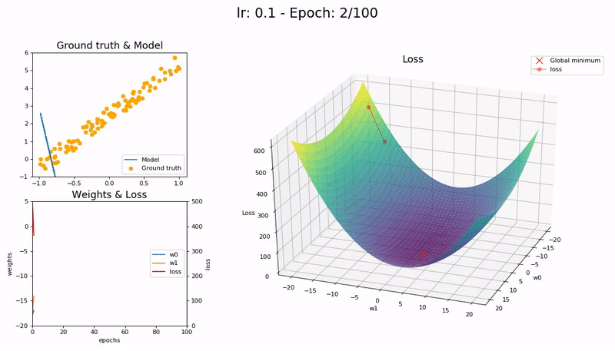
The importance of the learning rate
https://iconof.com/1cycle-learning-rate-policy/

Slide 8
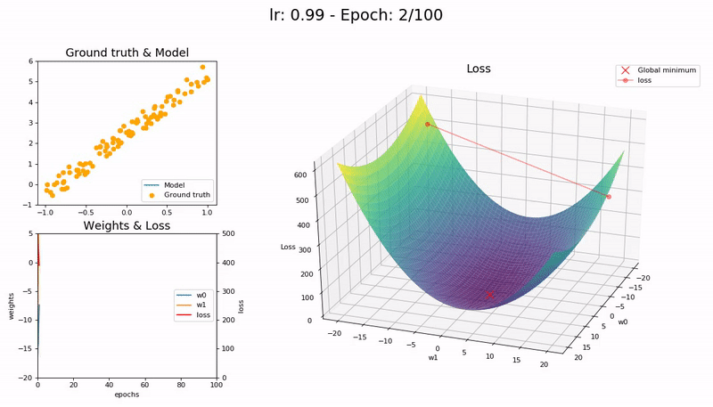
The importance of the learning rate
https://iconof.com/1cycle-learning-rate-policy/

Slide 9

The importance of the learning rate
https://iconof.com/1cycle-learning-rate-policy/

Slide 10
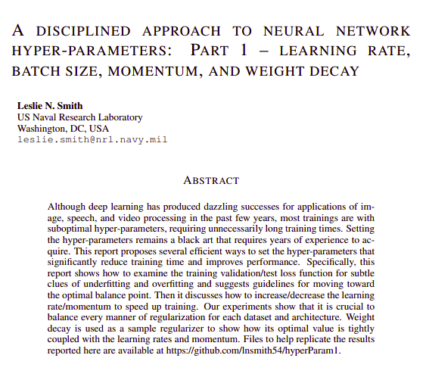
The one cycle policy as an ‘oscillator’ for learning rates
https://arxiv.org/pdf/1803.09820.pdf

Slide 11
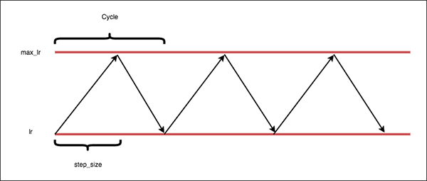
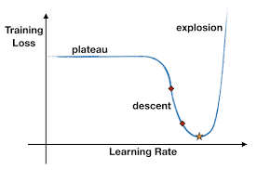
The one cycle policy as an oscillating learning rate
“CLRs leads to far fewer learning rate tuning experiments along with near identical accuracy to exhaustive hyperparameter tuning” source
Notes:
Define the lower bound on our learning rate (called “base_lr”).
Define the upper bound on the learning rate (called the “max_lr”).
Allow the learning rate to oscillate back and forth between these two bounds when training, slowly increasing and decreasing the learning rate after every batch update.

Slide 12
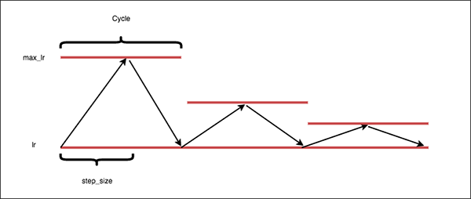
The learning rate finder
“CLRs leads to far fewer learning rate tuning experiments along with near identical accuracy to exhaustive hyperparameter tuning” source
Notes:
Define the lower bound on our learning rate (called “base_lr”).
Define the upper bound on the learning rate (called the “max_lr”).
Allow the learning rate to oscillate back and forth between these two bounds when training, slowly increasing and decreasing the learning rate after every batch update.

Slide 13
Image classification: pet breeds
Please read (in Google Colab) everything under the section “improving our model”
https://github.com/fastai/fastbook/blob/master/05_pet_breeds.ipynb

Slide 14
Review questions on the learning rate
What is the one-cycle policy doing?
What is the learning rate finder doing?
What are discriminative learning rates?
Why do we use discriminative learning rates?

Slide 15
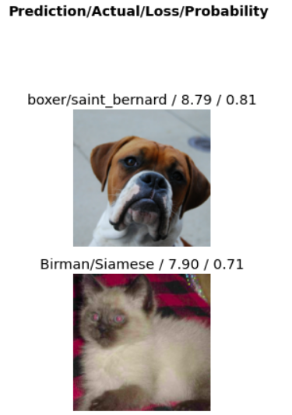
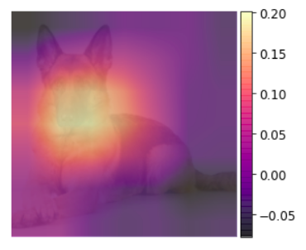
Image classification: pet breeds
Chapter 5 of the FastAI book

Slide 16
Image classification: pet breeds
Exercise
Solution

Slide 17
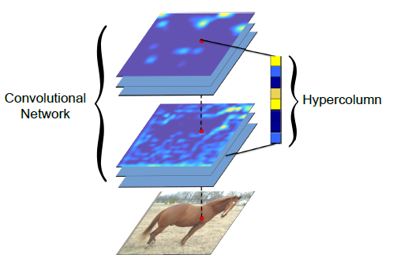
“Hypercolumns”
Notes:
A heatmap is predicted and then resized to the size of the expanded bounding box or full image target and splat onto the image. The combination of heatmaps for every pixel is treated as a combined ‘multi-scale’ feature

Slide 18
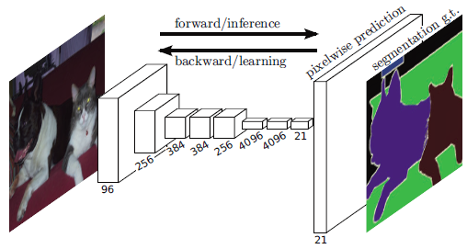
“Fully Convolutional” networks ‘localize’ labels
All layers in the network are convolutional, there is no fully connected (aka “dense”) layer like in most classifiers, we use the local info of the pixel neighborhood

Slide 19
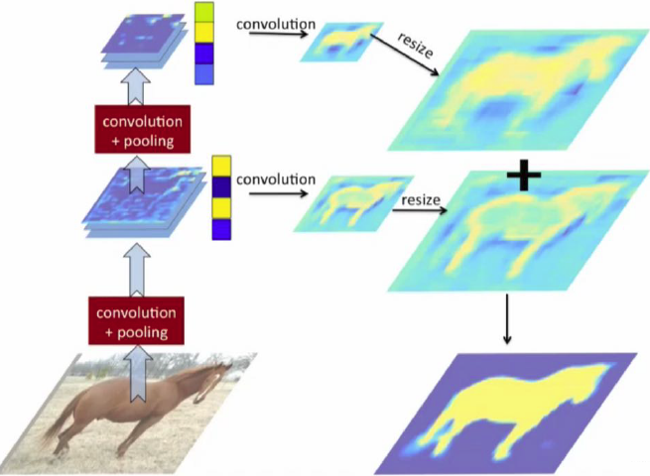
“Hypercolumns”
Notes:
A heatmap is predicted and then resized to the size of the expanded bounding box or full image target and splat onto the image. The combination of heatmaps for every pixel is treated as a combined ‘multi-scale’ feature

Slide 20

“Fully Convolutional” networks draw segmentation masks
All layers in the network are convolutional, there is no fully connected (aka “dense”) layer like in most classifiers, we use the local info of the pixel neighborhood

Slide 21

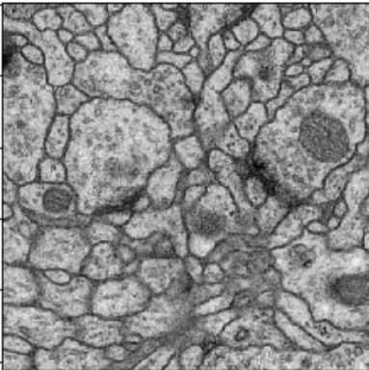
U-net for binary semantic segmentation
All layers in the network are convolutional, there is no fully connected (aka “dense”) layer like in most classifiers, we need this fully convolutional architecture to label images pixel by pixel preserving their local info

Slide 22
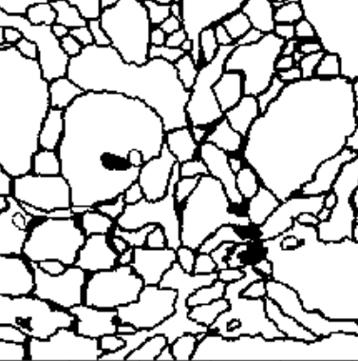
U-net for binary semantic segmentation
All layers in the network are convolutional, there is no fully connected (aka “dense”) layer like in most classifiers, we need this fully convolutional architecture to label images pixel by pixel preserving their local info

Slide 23
“Fully Convolutional Networks” allow pixelwise prediction
All layers in the network are convolutional, there is no fully connected (aka “dense”) layer like in most classifiers, we use the local info of the pixel neighborhood

Slide 24
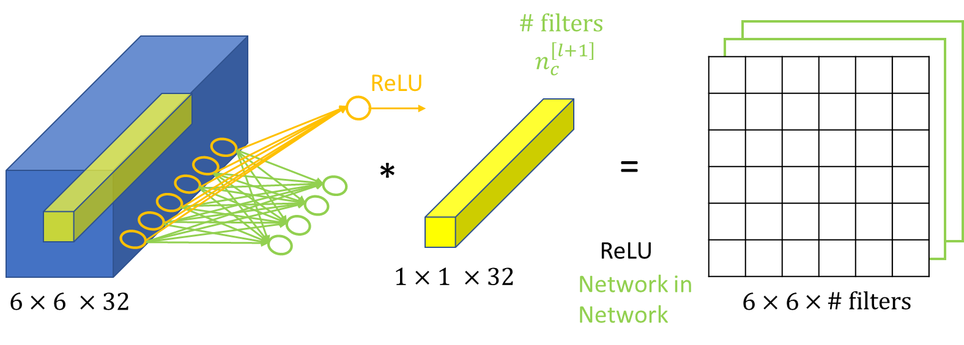
“1x1” convolutions
A Gentle Introduction to 1×1 Convolutions
Tutorial on 1 x 1 Convolutions by Andrew Ng

Slide 25
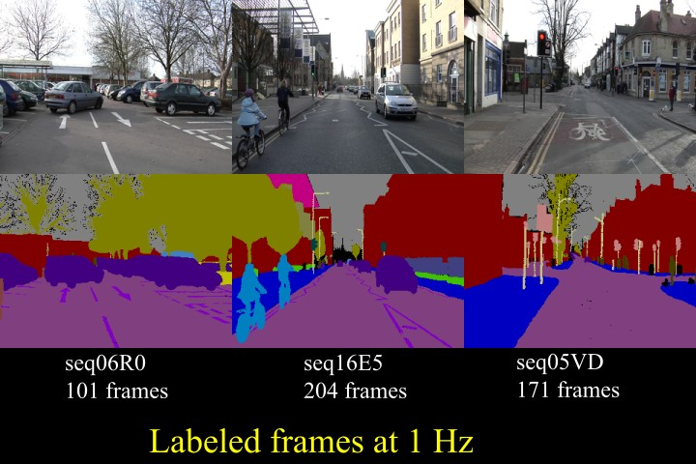
The CAMVID segmentation dataset
http://mi.eng.cam.ac.uk/research/projects/VideoRec/CamVid/

Slide 26
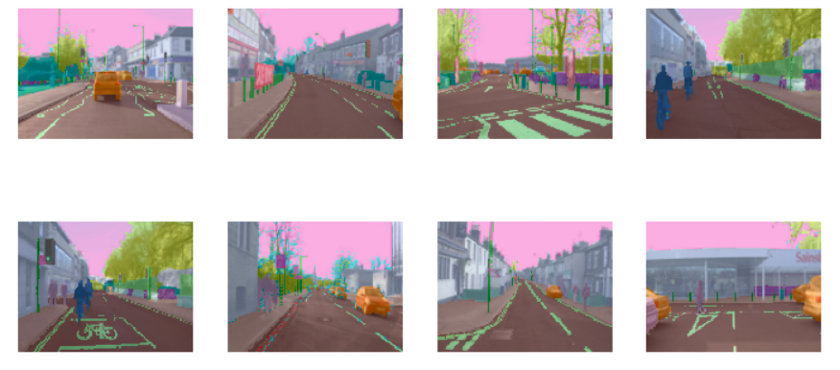
Semantic segmentation with Unet: Camvid
http://mi.eng.cam.ac.uk/research/projects/VideoRec/CamVid/

Slide 27
Semantic segmentation with Unet: Camvid
Exercise
Solution (with small images)
Solution with large images
Why is the quality of the results so different among these two versions of the Camvid dataset?
In the small dataset, would using a bigger model (e.g. ResNet50) help?
Why did we use smaller batch sizes when running the dataset with larger images?

Slide 28
Convolutional networks as embeddings creators

Slide 29
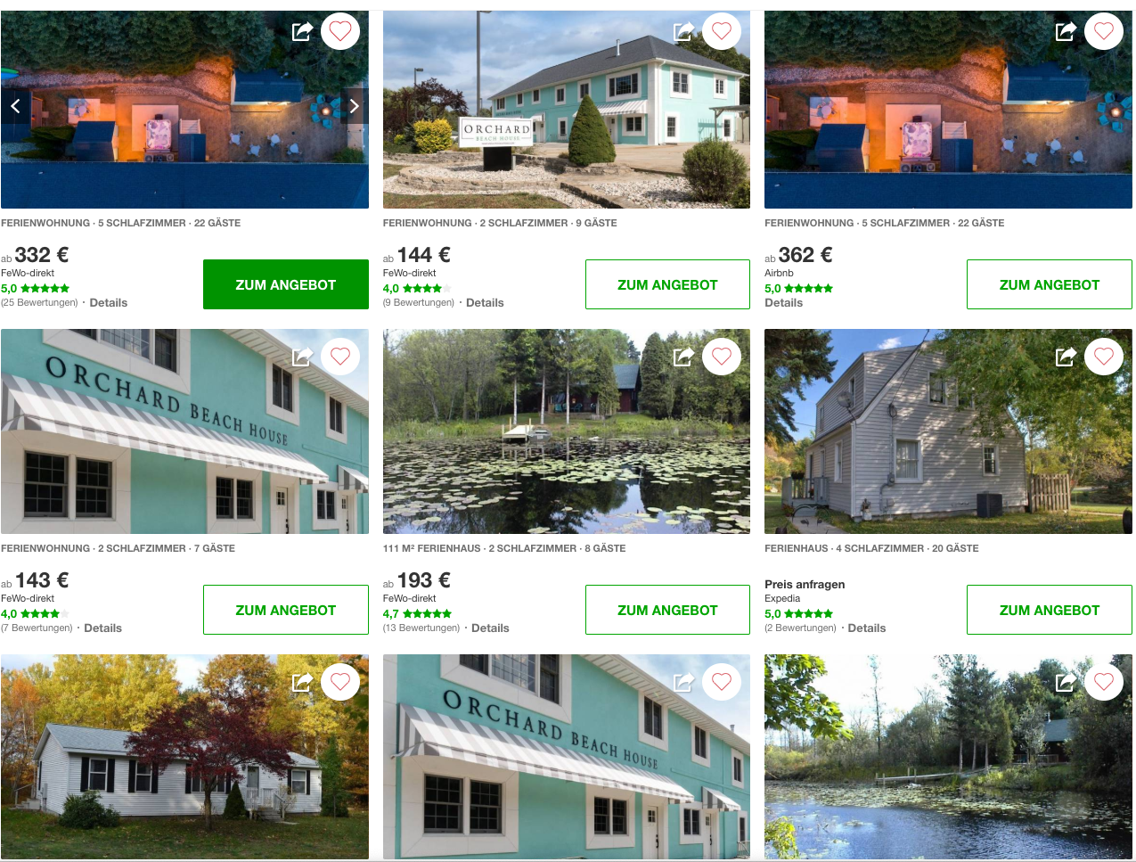

Primary image matching at Hometogo
Inventory understanding (500 million images)
Providing the best deals to users (sample use case: strike prices)

Slide 30
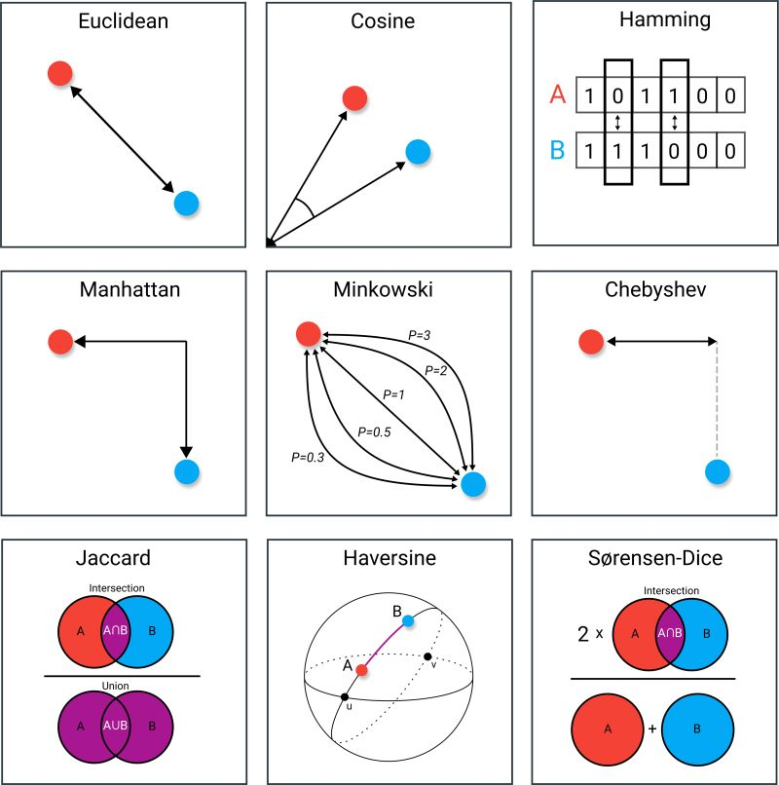

Slide 31
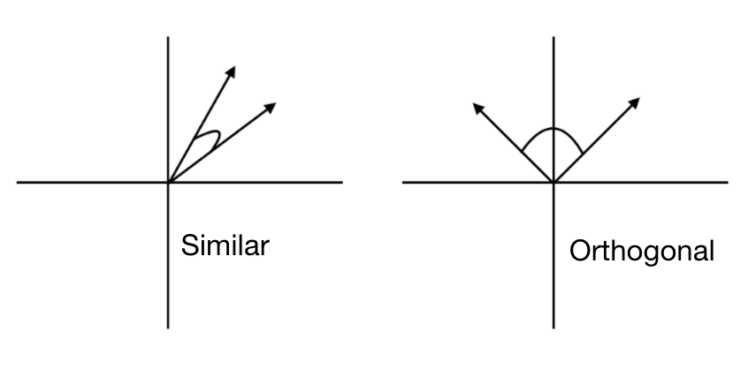
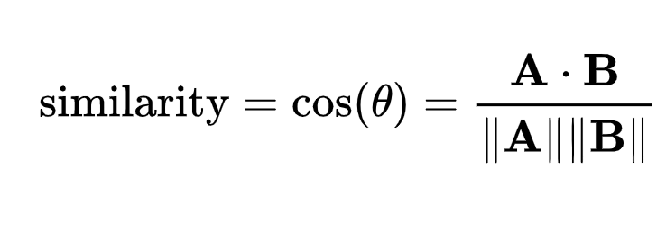
Cosine Similarity

Slide 32
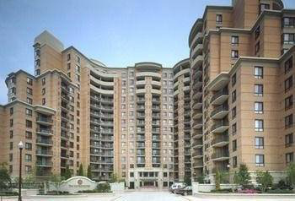
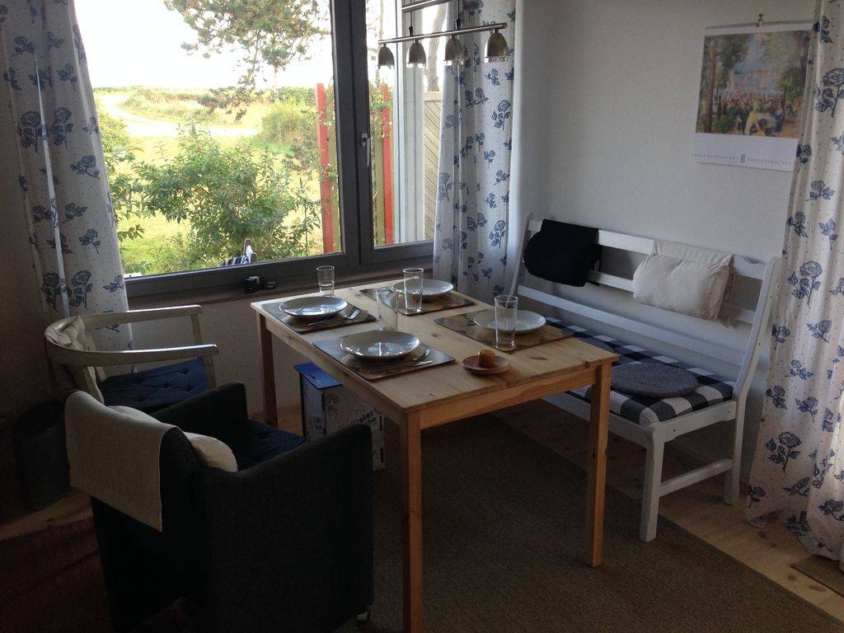
Convolutional networks as embeddings creators
Cosine similarity = 0.65
Notes:
Add pair of bedrooms and their cosine similarity

Slide 33
Convolutional networks as embeddings creators
Cosine similarity = 0.99
Notes:
Add pair of bedrooms and their cosine similarity

Slide 34
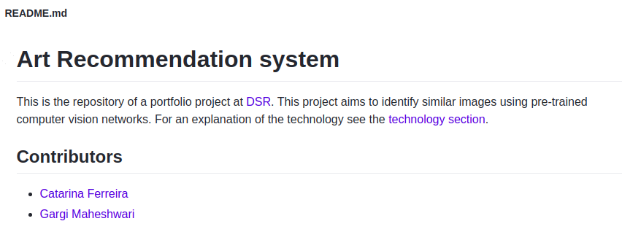
https://github.com/gargimaheshwari/Wikiart-similar-art

Slide 35
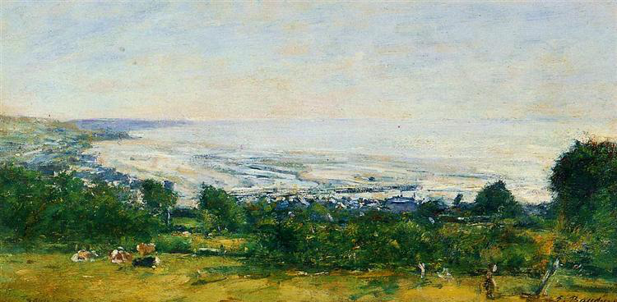
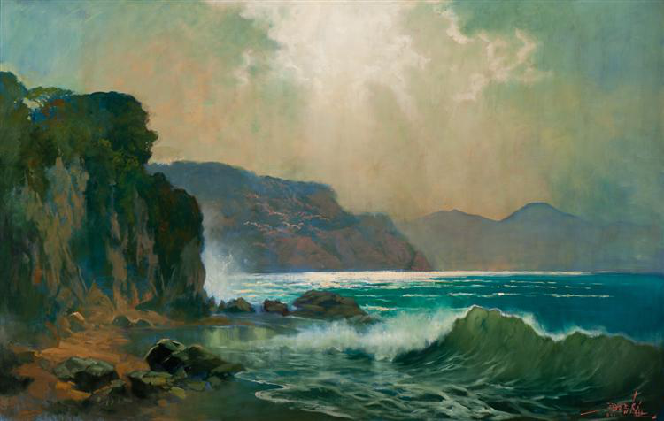
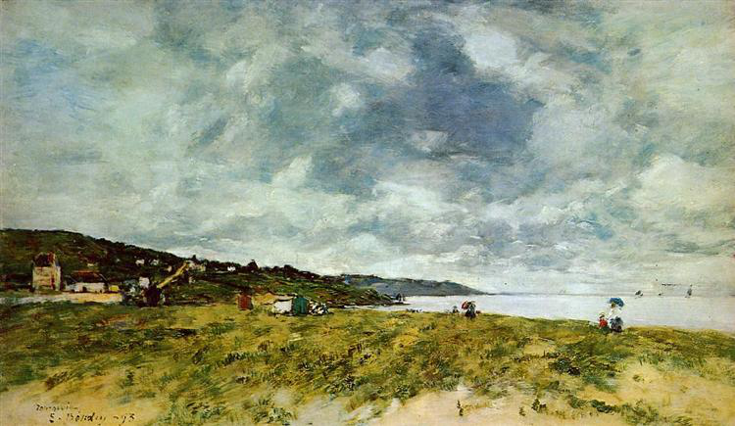
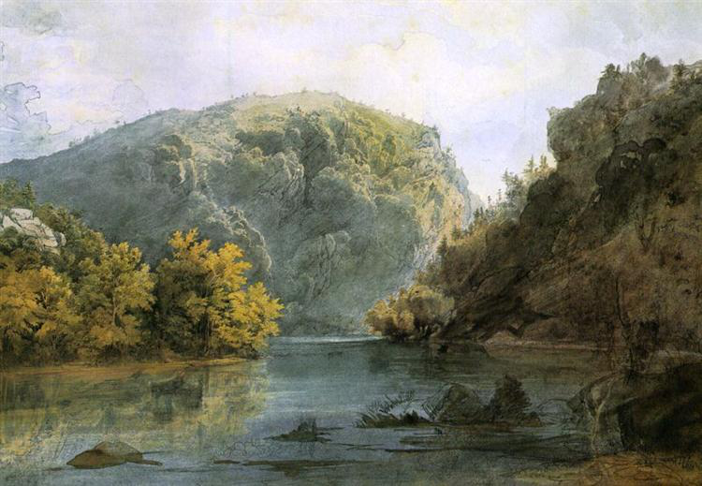
Notes:
Images with cosine similarity above 0.7 to the query image (top left)

Slide 36
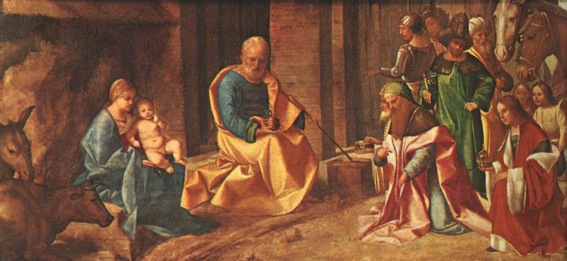
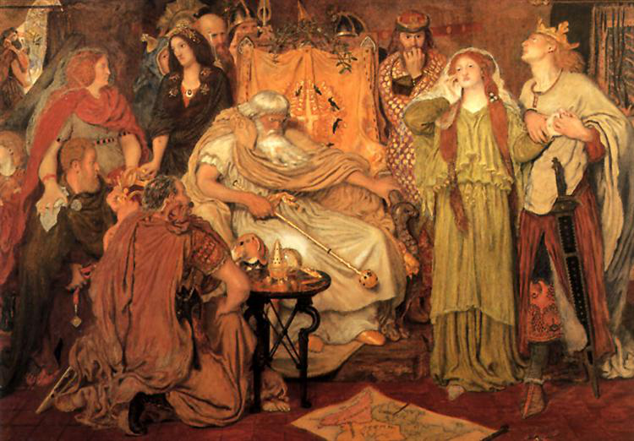
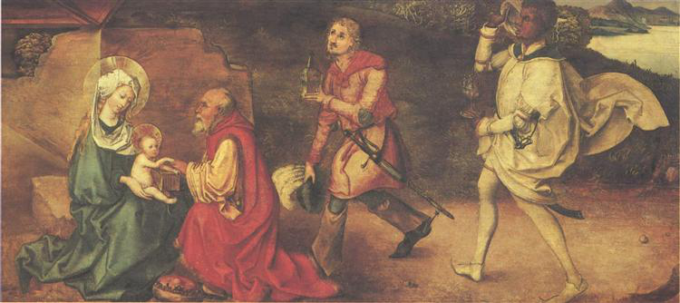
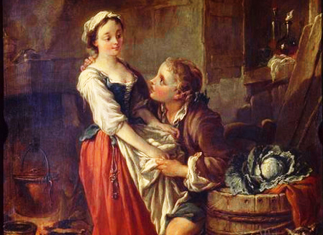
Notes:
Images with cosine similarity above 0.8 of the query image (top left)

Slide 37
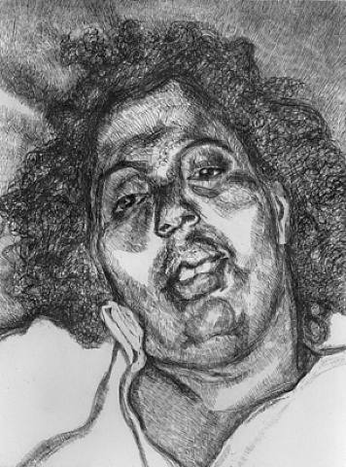
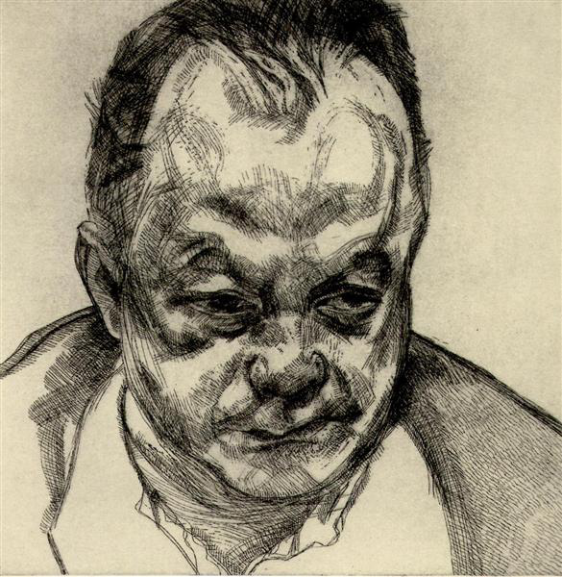
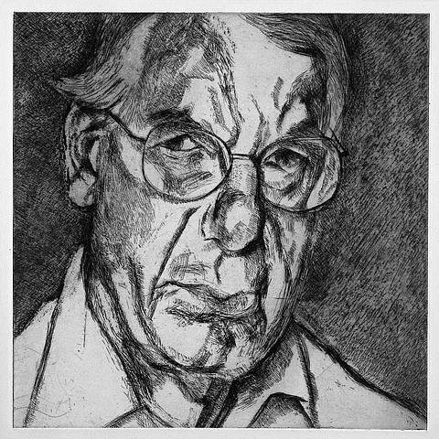
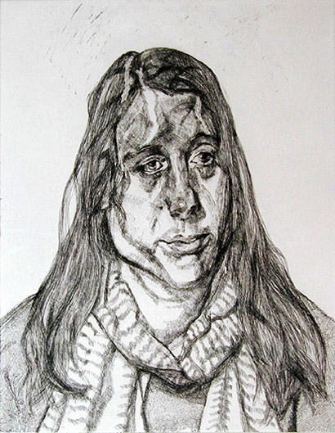
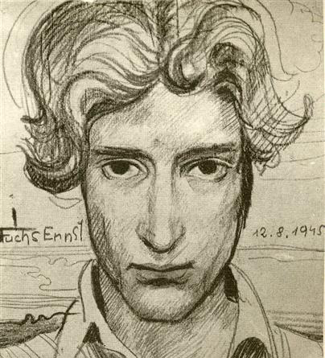
Notes:
Images with cosine similarity above 0.8 of the query image (eft)

Slide 38
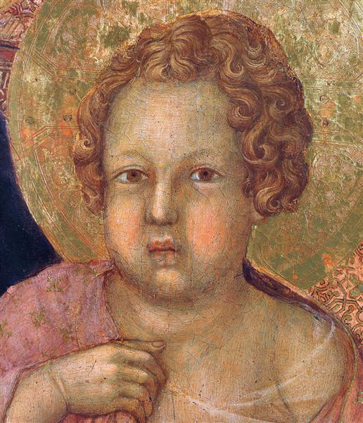
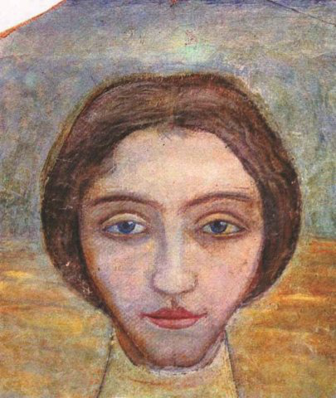
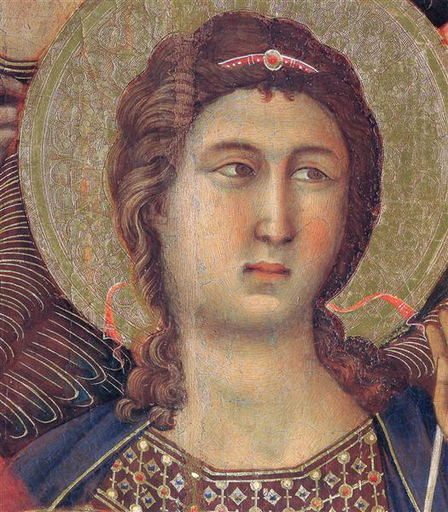
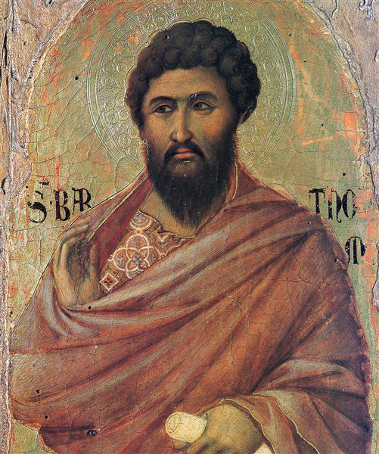
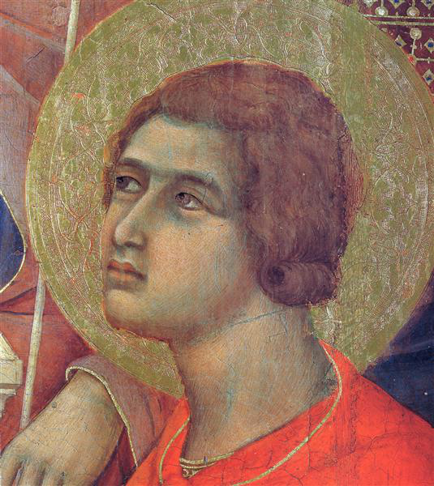
Notes:
Images with cosine similarity above 0.8 to query image (top left)

Slide 39
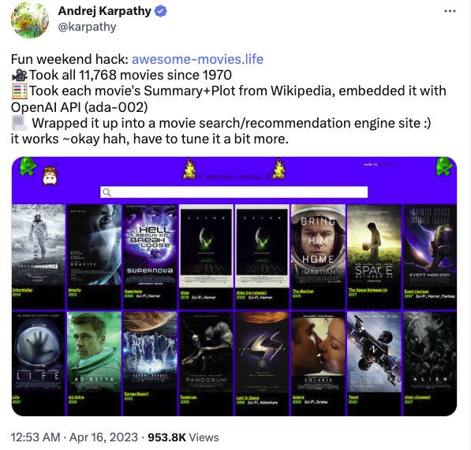

Slide 40
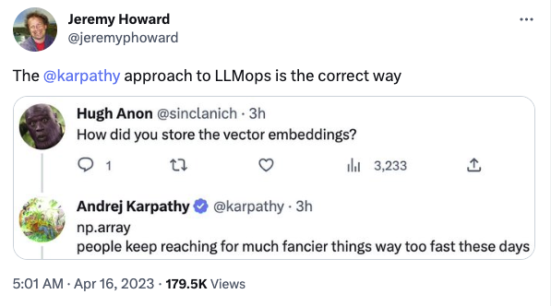

Slide 41
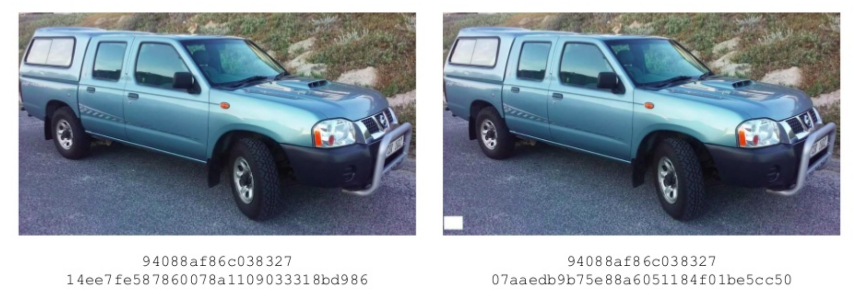
Perceptual hashing

Slide 42
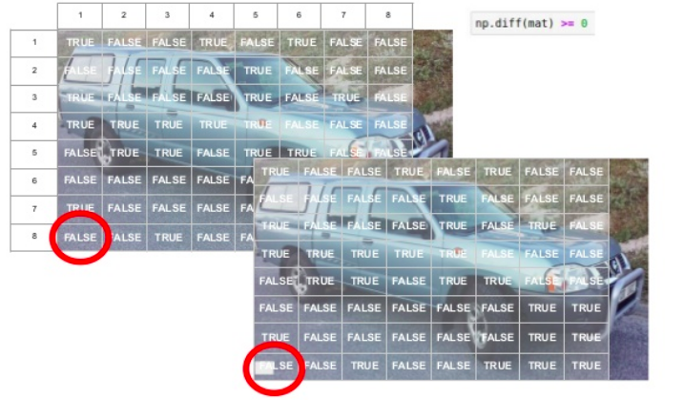
Perceptual hashing

Slide 43
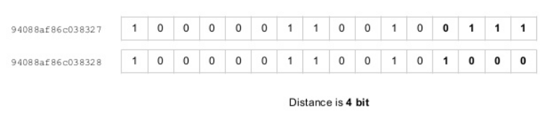
Perceptual hashing

Slide 44
Image similarity
Exercise
Solution

Slide 45
Review questions
In terms of interpretability for image similarity, what is one benefit of using the cosine similarity over the Euclidean distance?

Slide 46
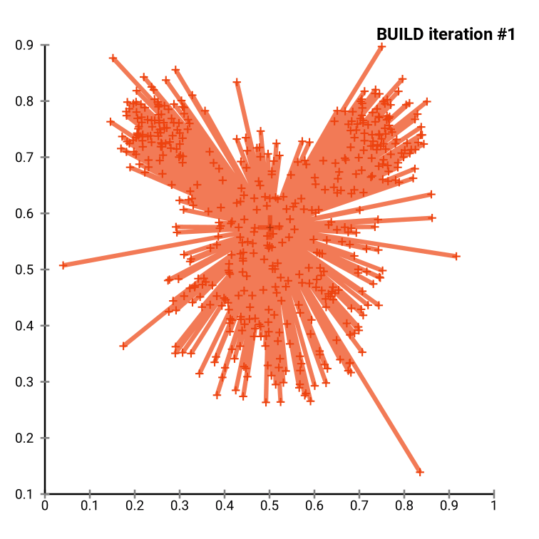
K-medoids clustering

Slide 47
Image clustering
Exercise
Solution
V2 Exercise (all images)
V2 Solution (all images)

Slide 48
Review questions
Explain the differences between:
K-medoids
K-means
K-nearest neighbors
Why is the elbow method not a hard rule but a heuristic?
Name two other ways in which we can create embeddings for images
How can we use the methods that we have seen in the previous examples to create embeddings for audio data? (hint)
Using the code from previous examples, how would you create embeddings for a set of video frames?

Slide 49
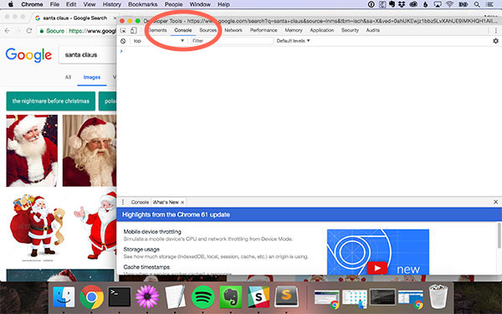
Scraping a dataset from Google Images
PyImageSearch guide

Slide 50
Goals of object detection
Given an input image we wish to obtain:
1. A list of bounding boxes, or the (x, y)-coordinates for each object in an image
2. A class label associated with each bounding box
3. The probability score associated with each bounding box and class label

Slide 51
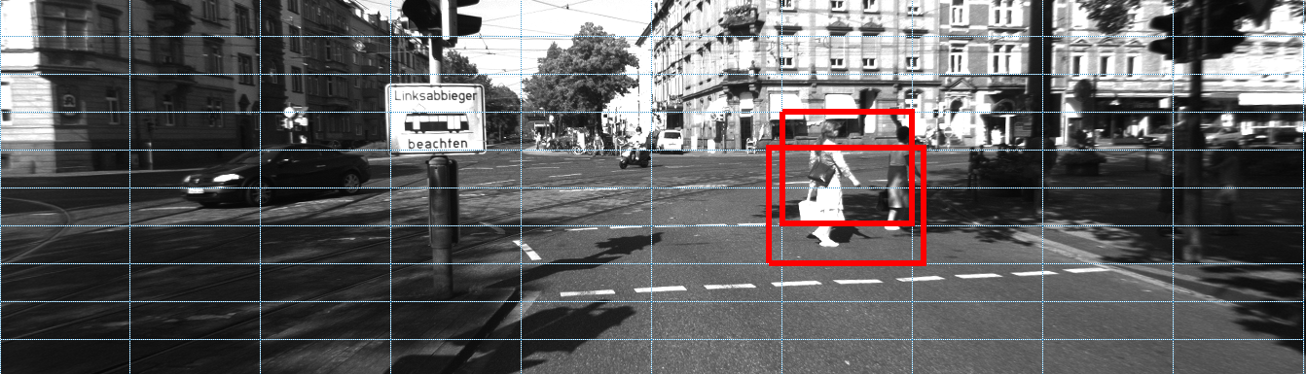
Breaking down an image into regions

Slide 52

Breaking down an image into regions
A sliding window approach partitions the image into discrete blocks

Slide 53

Breaking down an image into regions

Slide 54

Breaking down an image into regions
Finding the optimal image partitioning algorithm is not a trivial task

Slide 55

Transfer learning of classification is currently used for region proposals
Source

Slide 56

Breaking down an image into regions

Slide 57

Measuring performance with IoU

Slide 58

Measuring performance with IoU

Slide 59



Precision, recall, and f1 metrics
True Positive = dog (pixel) labeled as dog (pixel)
True Negative = non dog (pixel) labeled as non dog (pixel)
False Positive = non dog (pixel) labeled as dog (pixel)
False Negative = dog (pixel) labeled as non dog (pixel)

Slide 60

Understanding mean Average Precision (mAP)
Notes:
https://blog.paperspace.com/mean-average-precision/#:~:text=To%20evaluate%20object%20detection%20models,model%20is%20in%20its%20detections.

Slide 61

Understanding mean Average Precision (mAP)
https://pjreddie.com/darknet/yolo/
Notes:
https://medium.com/@jonathan_hui/map-mean-average-precision-for-object-detection-45c121a31173

Slide 62
Mean average precision
Exercise
Solution

Slide 63

Sliding windows

Slide 64

Image pyramids
Notes:
An image pyramid is simply a multi-scale representation of an image (Figure 13.1, right). Using an image pyramid allows us to find objects in images at different scales of an image.
At the bottom of the pyramid, we have the original image at its original size (in terms of width and height). At each subsequent layer, the image is resized (subsampled). The image is progressively subsampled until some stopping criterion is met which is typically a minimum size being reached, indicating that no further subsampling needs to take place.
An image pyramid is simply a multi-scale representation of an image (Figure 13.1, right). Using an image pyramid allows us to find objects in images at different scales of an image.
At the bottom of the pyramid, we have the original image at its original size (in terms of width and height). At each subsequent layer, the image is resized (subsampled). The image is progressively subsampled until some stopping criterion is met which is typically a minimum size being reached, indicating that no further subsampling needs to take place.

Slide 65

Sliding windows on an image pyramid

Slide 66

Image Pyramids

Slide 67

Image Pyramids

Slide 68

Sliding windows

Slide 69

Anchor boxes
Notes:
Notice how none of the anchor boxes captures the full size of the horse

Slide 70

Anchor boxes
Notes:
Notice how none of the anchor boxes captures the full size of the horse

Slide 71

Anchor boxes
Notes:
Notice how none of the anchor boxes captures the full size of the horse

Slide 72

Non-max suppression

Slide 73

Non-max suppression

Slide 74

https://www.youtube.com/watch?v=RTlwl2bv0Tg

Slide 75

Object detection as bounding box regression (1st step)
‘Regression’ means predicting a continuous value
Notes:
Computing the center of the bounding box and its dimensions is a regression problem, the distance between the predicted box coordinates (red) and the true box coordinates (black) is used to compute the loss function that we use to adjust the network’s weights. It’s important to understand that this ‘regression’ means predicting a continuous value, it does not refer to linear or logistic regression

Slide 76

Object detection as classification (2nd step)
After step 1, a classification algorithm (SVM, another neural network, etc.) will output a class label
REF
Notes:
Computing the center of the bounding box and its dimensions is a regression problem, the distance between the predicted box coordinates (red) and the true box coordinates (black) is used to compute the loss function that we use to adjust the network’s weights. It’s important to understand that this ‘regression’ means predicting a continuous value, it does not refer to linear or logistic regression

Slide 77

Object detection as bounding box localization

Slide 78

Object detection as bounding box localization
Notes:
Score is the confidence of the model in the label, location

Slide 79

Instance segmentation requires object detection

Slide 80

Segmentation as pixel-wise localization

Slide 81

Segmentation as pixel-wise localization
Link

Slide 82

Segmentation as pixel-wise localization

Slide 83

Segmentation as pixel-wise localization

Slide 84

Panoptic segmentation
https://arxiv.org/pdf/1801.00868.pdf
Explore it in the detectron2 inference notebook

Slide 85
Two main families of object detection methods
Two stage methods (R-CNN family)
1st stage: use a region proposal method to select possible object areas
2nd stage: classify proposed regions
Two stage methods are accurate, but slow
Single stage methods (YOLO, Retinanet, and SSD):
No region proposal
Single stage methods are fast, but less accurate

Slide 86

Single Shot Detectors
Single shot detectors make predictions of feature maps at different scales (different sizes for the bounding box) and compute cross entropy on a fully convolutional network that takes all these activation scales as input
Notes:
Single shot detectors make predictions of feature maps at different scales, look at the downsampling applied in the figure
A key difference between the two architectures is that the YOLO architecture utilizes two fully connected layers, whereas the SSD network uses convolutional layers of varying size

Slide 87

Retinanet’s solution to the class imbalance problem
RetinaNet: how Focal Loss fixes Single-Shot Detection

Slide 88

‘You only look once’ (YOLO)
Notes:
A key difference between the two architectures is that the YOLO architecture utilizes two fully connected layers, whereas the SSD network uses convolutional layers of varying size

Slide 89

Cross entropy at different confidence levels
Andrew Ng’s explanation of cross entropy loss

Slide 90

Regular cross entropy gives too much importance to easy cases

Slide 91

Retinanet’s solution to the class imbalance problem
Notes:
The higher the probability of the class label, the lower the contribution to the overall loss

Slide 92



Focal loss as modified cross-entropy loss
Colab notebook to play with these equations
Notes:
To avoid the contribution of easy examples to the loss, we diminish their losses by using multiply by 1 — their probabilities

Slide 93

Tweaking gamma 𝛾
𝛾 = 0 regular cross entropy (no focus on infrequent samples)
𝛾 = 2 show

Slide 94

No free lunch: experiments must be done
Extract from the YOLOv3 paper

Slide 95

‘You only look once’ (YOLO)
YOLOv1 from scratch in PyTorch (2 hours)
YOLOv3 from scratch in PyTorch (2 hours)
Notes:
A key difference between the two architectures is that the YOLO architecture utilizes two fully connected layers, whereas the SSD network uses convolutional layers of varying size

Slide 96
Two stage detectors: R-CNN variants
R-CNN: Selective Search is run on the image, output segments from Selective Search are used for feature extraction and classification using a pre-trained CNN (two networks, separate training)
Fast R-CNN: Uses the Selective Search algorithm to obtain region proposals, adding the Region of Interest (ROI) Pooling module. Extracts a fixed-size window from the feature map and uses the features to obtain the class label and bounding box. The network is now end-to-end trainable
Faster R-CNN: Introduces the Regional Proposal Network (RPN) that puts the region proposal directly into the architecture, alleviating the need for the Selective Search algorithm. Produces better results at lower training and inference time.
Mask R-CNN: adds a convolution mask filter to the Faster R-CNN architecture to generate instance segmentation masks

Slide 97
R-CNN
Step #1: Input an image and segment it into blobs
Step #2: Extract regions proposals using the Selective Search algorithm
Step #3: Select the regions of interest with higher object activations using a pretrained network, warp them to standard size (e.g. 128x128) and output proposals of objects
Step #3 Classify each proposal using the extracted features with a Support Vector Machine (SVM)
Notes:
R-CNN runs a ‘Selective Search’ algorithm over a variety of bounding boxes at different image pyramids. It then uses a pretrained network to extract region proposals.

Slide 98

R-CNN
Notes:
R-CNN runs a ‘Selective Search’ algorithm over a variety of bounding boxes at different image pyramids. It then uses a pretrained network to extract region proposals.

Slide 99

R-CNN
Region Proposals
Notes:
R-CNN runs a ‘Selective Search’ algorithm over a variety of bounding boxes at different image pyramids. It then uses a pretrained network to extract region proposals.

Slide 100

Fast R-CNN
Notes:
ROI pooling can be applied to speed up the network.

Slide 101


Region Proposal Networks - Faster R-CNN
Faster R-CNN breakdown
Notes:
The region proposal network has a classifier and a regressor.

Slide 102

Region Proposal Networks - Faster R-CNN
Notes:
The region proposal network has a classifier and a regressor.

Slide 103


Keypoint detection
Towards Accurate Multi-Person Pose Estimation in the Wild

Slide 104

https://openaccess.thecvf.com/content_cvpr_2017/papers/Papandreou_Towards_Accurate_Multi-Person_CVPR_2017_paper.pdf

Slide 105

ROI Pooling- Faster R-CNN
Notes:
The region proposal network has a classifier and a regressor.

Slide 106

Faster R-CNN

Slide 107
Image Pyramids in Feature Proposal Networks (FPNs)

Slide 108

Mask R-CNN
Notes:
https://towardsdatascience.com/review-hypercolumn-instance-segmentation-367180495979

Slide 109

Use an API - avoid manual implementation
Notes:
From PyImageSearch Imagenet Bundle page

Slide 110
Popular Implementations
Tensorflow’s object detection API
Matterport’s Mask-RCNN
Facebook’s Detectron (PyTorch)

Slide 111

The COCO dataset
http://cocodataset.org/#explore

Slide 112

The Google Open Images Dataset
Notes:
Size of the dataset: Download size: 534.63 GiB
https://www.tensorflow.org/datasets/catalog/open_images_challenge2019_detection
https://storage.googleapis.com/openimages/web/visualizer/index.html?set=train&type=detection&c=%2Fm%2F0b_rs

Slide 113


Slide 114

Models trained on the Open Images Dataset
Notes:
https://github.com/tensorflow/models/blob/master/research/object_detection/g3doc/detection_model_zoo.md

Slide 115


Using pretrained models
Using a Mask R-CNN pretrained on COCO to catch parking spaces

Slide 116

Input Image

Slide 117

Mask R-CNN pretrained on COCO (inventory image)

Slide 118

SSD pretrained on Google Open Images

Slide 119

Input image

Slide 120

Mask R-CNN trained on COCO

Slide 121

SSD trained on Open Images Dataset

Slide 122

Creating training and test sets
https://requester.mturk.com/
Notes:
Evaluating the ambiguous indoor images from the image classification test set https://docs.google.com/spreadsheets/d/1GlfMJROL_R6HAcsqiFVKWfw1oTi23CRHEa5XVbNXH1Q/edit#gid=1281341257

Slide 123

Creating training and test sets
https://github.com/tzutalin/labelImg
Notes:
Evaluating the ambiguous indoor images from the image classification test set https://docs.google.com/spreadsheets/d/1GlfMJROL_R6HAcsqiFVKWfw1oTi23CRHEa5XVbNXH1Q/edit#gid=1281341257

Slide 124

Creating training and test sets
labelme: Image Polygonal Annotation with Python
Notes:
Evaluating the ambiguous indoor images from the image classification test set https://docs.google.com/spreadsheets/d/1GlfMJROL_R6HAcsqiFVKWfw1oTi23CRHEa5XVbNXH1Q/edit#gid=1281341257

Slide 125

https://cocodataset.org/#explore

Slide 126
Notebooks for Tensorflow implementations
Mask R-CNN
YOLO
RetinaNet
SSD and Faster RCNN comparison on Open Images Dataset v4
Faster R-CNN trained on Open Images Dataset v4
Using a TF-hub object detection model

Slide 127

Detectron2
detectron2/MODEL_ZOO.md at master · facebookresearch/detectron2 · GitHub
Recommended reading: digging into Detectron2

Slide 128

Detectron2 config files

Slide 129

https://github.com/facebookresearch/detectron2/blob/master/MODEL_ZOO.md

Slide 130

https://detectron2.readthedocs.io/tutorials/models.html#model-output-format

Slide 131
Detectron exercises
Inference (Exercise)
Inference (Solution) - here change the input image with a change to wget
Training (Exercise) - this one is broken, sorry
Training (Solution)

Slide 132

Case study

Slide 133


Slide 134

https://storage.googleapis.com/openimages/web/index.html

Slide 135

https://storage.googleapis.com/openimages/web/visualizer/index.html?set=train&type=detection&c=%2Fm%2F04rmv

Slide 136

https://storage.googleapis.com/openimages/web/visualizer/index.html?set=train&type=segmentation&r=false&c=%2Fm%2F03g8mr

Slide 137

Case study

Slide 138

Colab notebook

Slide 139
Review questions
What is a common issue with segmenting small images with a U-net?
What is the point of using FastAI? What is it? What does it offer (other than a ton of bugs)?
What is perceptual hashing? How does it differ from cryptographic hashing?
How do we compute the Hamming distance for two hashes?
What are the use cases for embeddings from a pretrained network? How is this transfer learning?
Which inputs do we need to train an image segmentation model from scratch?
Which inputs do we need to train an object detector from scratch?
How is the ‘error rate’ metric for classification defined? Should we use it for imbalanced datasets?
How do we compute the confusion matrix for a segmentation mask? How do we compute it for a bounding box?

Slide 140
Review questions
What’s the recall of a classifier that only outputs ‘1’ (positive class)?
What’s an “hypercolumn”?
Does the F2 measure weigh precision and recall equally?
How do deep learning object detection methods reduce the search space of detection regions? How does object detection exploit transfer learning of image classification in Imagenet?
What are the two families of object detection method?

Slide 141
Review questions
What’s the appeal of using Detectron2? Do we need to write a Pytorch model to use it for inference or training with Detectron?
How does panoptic segmentation combine instance and semantic segmentation? Which method produces the ‘stuff’? Which method produces the ‘things’?
Suppose that you wish to detect objects in video and you only have a modest embedded processor, would you solve this problem using YOLO or using Faster RCNN? How would you argue in favor of using either method?
Is semantic segmentation more computationally costly than instance segmentation? Why?

Slide 142
References
Stanford’s cs231n lecture on Object Detection and Segmentation
PyImageSearch tutorial on Mask R-CNN
Training Faster R-CNN on the Google Open Images Dataset
Focal loss for Single Shot Detectors
Training an object detector on Google Colab

